Slide 1
Pathology
GP User Survey feedback
Pathology Quality Team
ghnt.pathologyquality@nhs.net

Slide 2
Improvement Suggestion comments from our users
Communications
“Possible AKI - practice should be informed regardless of level of drop in egfr so it does not get missed/ left in an inbox”
Confirmed by Clinical Biochemists ….. Our procedure is to phone all new occurrences of AKI Alert 2 and AKI Alert 3. We phone AKI Alert 1 if the potassium is >/= 6.0 mmol/L. In addition, all levels of AKI Alert will flag as abnormal for review. This is in line with national recommendations (RCPath) and regional consensus.
“To be informed of outages and plans in an event of outage.”
Issue raised at ICE User Group and new communication SOP created which documents contact emails and numbers for urgent and non urgent communications to GPs.
“I have a challenge with blood tests in care homes now that I use Zebra printer - as shows as being sampled on day I print off labels. If care home nurse is unable to get the bloods that day and they are taken the next day or week, the lab assume they are old samples... So, if not confident nurse will be able to get bloods that day, I end up taking them myself, but I really don't have time to be doing this... I might see if I can return to ICE paper for these so I can click to sample later and insert date and time”
The date on the ICE Electronic Order will pass straight through to the LIMS and the clock will start ticking. Printing an A4 request would have the same issue if bloods can’t be collected. Postponing the Request does NOT generate an electronic order into the LIMS, unless updated to sample collected, so would have to be manually entered at the laboratory. A future dated request may have to be manually entered if the sample reaches the laboratory before the Order reaches the LIMS.

Slide 3
Improvement Suggestion comments from users
Helpfulness of Staff over Telephone
“Customer service training for some staff”
Customer Service now forms part of Pathology Staff local induction. We also ask our users who do have issues, to provide details of staff involved, so that we can improve service.
Add On Tests
“I worry that these might not get done & we may not find out that not done”
We are currently looking to introduce a result comment for the Add on Test. This will allow clinicians to have more visibility and for the lab to identify tests not processed more easily.

Slide 4
Improvement Suggestions from users
Timeliness of responses to queries raised via email
Quality of results
Turnaround times of results
Courier Service
Friendliness of staff overall
Each of the areas above were either unanswered, skipped or answered as good and no issues identified

Slide 5
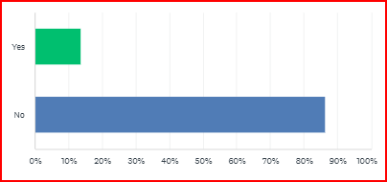
Awareness of Pathology Website
85% of Pathology Users were unaware of the Pathology website which includes helpful advice and information about our services, departments and tests.
The Pathology IT page has links to ICE User forms, Printer troubleshooting guides, etc
https://thepathologycentre.org

Slide 6
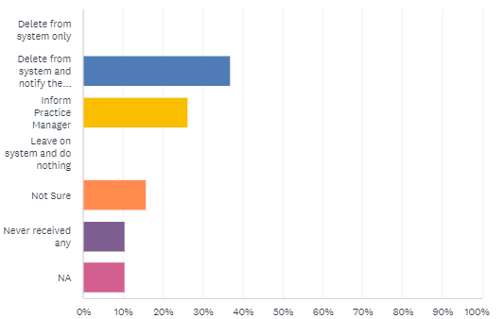
What practices do with results received which are not for their patient(s)
Some GP Practices were still unsure what to do……
Deleting a result message from the GP Clinical System will not notify the Laboratory that the result needs to be redirected.
You must email the patient and test details to Pathology IT ghnt.pathsupport@nhs.net

Slide 7
What do our GP Users think of Pathology
Comments from users……..
“if I have had to ring as I don’t know what bottle to put something in staff are very helpful”
“Rapid turnaround, helpful comments, always friendly and helpful when I call, excellent service being able to add on using ICE”
“if i have had to ring as I don’t know what bottle to put something in staff are very helpful”
“very friendly service and receiving results promptly”
“Always helpful when I need advice”
“quick turnaround of results”
“Good communication and always helpful if ring to ask a question or for support”
“Good service everything always gets delivered very quickly”
“turnaround of test very quick”
“Response to queries from our clinical staff. Supportive when it comes to checking on the IT side.”
“The results turnaround is very quick”

Slide 8
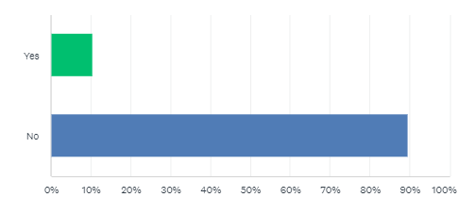
Are you interested in Joining ICE User Group?
Only two users expressed interest in joining the ICE User Group.
The meeting is on Teams, bi-monthly on Tuesdays at 2pm.
If you would like to join group, please email ghnt.pathologyquality@nhs.net

Slide 9
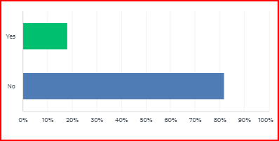
Have you had issues with any Department over last 12 months!
“Issues with quality of labels on samples reported by the lab however all printers were checked & no issues were identified with the labels or printers.
Suggestion – contact your IT Support NECS if problems persist
“ice label printer errors, that caused concerns”
Suggestion – contact your IT Support NECS if problems persist
“Wrong results this was not resolved attempted many times”
Actions – to avoid delays issues should be reported directly to Pathology IT ghnt.pathsupport@nhs.net telephone 0191 445 6504

Slide 10
Thank You …….
Your responses are important to us.
If you have any questions or queries please email the Quality Team ghnt.pathologyquality@nhs.net

